Slide 1

Student Details:
NAME:CHEBROLU PIYUSHA PRANATHI
SKILLBUILD EMAIL ID: 2200050010ECS@gmail.com
COLLEGE NAME: KLUNIVERSITY
BRANCH: ECS
PLACE: VIJAYAWADA, ANDHRA PRADESH
CYBER SECURITY DOMAIN AND FROM 3 JUNE, 2024 TO 12 JULY, 2024

Slide 2
Project Statement: Image Steganography
Key Features
Data Embedding
Data Extraction
Security and Robustness
User Interface

Slide 3
AGENDA
The agenda for the Image Steganography Project includes an introduction to steganography and project objectives. It involves researching existing techniques, defining requirements, and planning. Development focuses on embedding and extracting data, ensuring security with cryptographic techniques, and creating a user-friendly interface. Testing and evaluation involve test cases, performance checks, and user feedback. Documentation will cover design, implementation, and user guides. The finalization phase incorporates feedback, deploys the system, and completes reporting. The project concludes with a summary of achievements and future considerations.

Slide 4
PROJECT OVERVIEW
The Image Steganography Project aims to create a system for securely embedding and extracting hidden messages within digital images. It involves researching existing techniques, developing robust algorithms for data embedding and extraction, and ensuring security through cryptographic methods. The project includes designing a user-friendly interface and testing for performance and robustness. Comprehensive documentation and user guides will be prepared. The final system will be deployed, ensuring the secure and imperceptible concealment of messages within images.

Slide 5
WHO ARE THE END USERS of this project?
- Government agencies needing secure communication methods.
- Cybersecurity professionals seeking advanced data protection techniques.
- Journalists and activists requiring confidential information sharing.
- Businesses needing digital watermarking for intellectual property protection.
- IT departments ensuring data integrity and confidentiality.
- Academics and researchers in digital security and data privacy fields.
- Individuals desiring secure and covert communication methods.

Slide 6
YOUR SOLUTION AND ITS VALUE PROPOSITION
Solution:
The solution involves developing a comprehensive image steganography system that securely embeds and extracts hidden messages within digital images. This system will include robust algorithms for data embedding and extraction, ensure high security through cryptographic techniques, and maintain the visual quality of images.
Propostion:
Enhanced Security
Data Integrity
Intellectual Property Protection

Slide 7
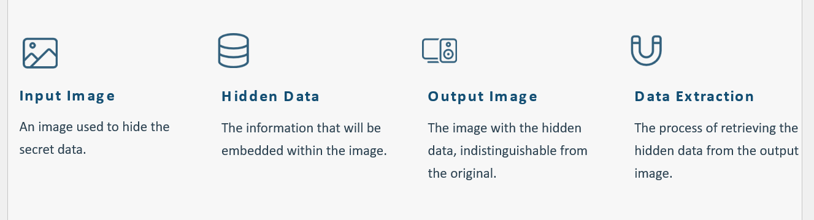
How did you customize the project and make it your own

Slide 8
MODELLING
1. Research and Background
2. Project Planning
3. System Design
4. Implementation
5. Evaluation and Conclusion

Slide 9
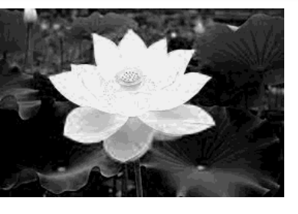
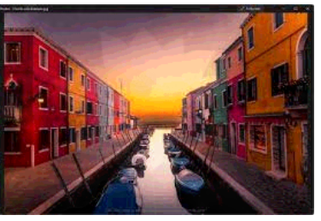
Results
Unmerged image: merged image:

Slide 10
link
https://github.com/pranathichebrolu/steganography

